Slide 1
COSE471(02); Spring quarter, 2017
Word2Vec을 기반으로 한
Text Understanding
2012210106 박찬혁
2014210097 박준형

Slide 2
Word2Vec 성능개선

Slide 3
Word2Vec
- ODP-based taxonomy

Slide 4
Semantic Contextual
Advertising Based on
the Open Directory Project

Slide 5
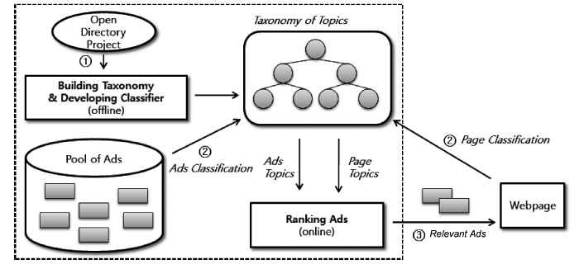
Contextual Advertising Engine
- Overview

Slide 6
Contextual Advertising Engine
- ODP-based taxonomy

Slide 7


Contextual Advertising Engine
- Merge-Centroid classifier

Slide 8
Fusion

Slide 9
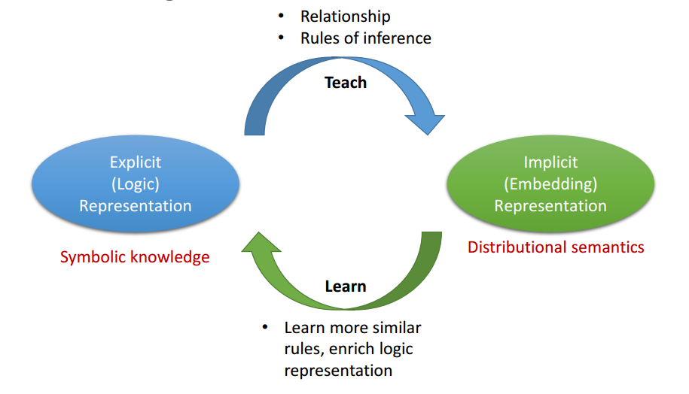
Fusion
Plan

Slide 10
Fusion
방법1

Slide 11
Fusion
방법2

Slide 12
Fusion
tf-idf-wv
Word vectors
tf-idf
New vector

Slide 13
Fusion
Modified tf-idf with Word2Vec
Original
dictionary
=
.. , media, .. .. , press, ..
Treat similar words as one
Modified
dictionary
=
.., wordset n, ..

Slide 14
Project
Progress
1차 발표
2차 발표
3차 발표
Word2Vec 성능 개선
Classifier 구현,
Fusion
Fusion,
성능개선
Word2Vec 구현

Slide 15
Repository
https://github.com/pch8944/DS_Word2Vec

Slide 16
References
JUNG-HYUN LEE, JONGWOO HA, JIN-YONG JUNG, & SANGKEUN LEE. (2013). Semantic Contextual Advertising Based on the Open Directory Project. ACM Transactions on the Web, Vol. 7
Xin Rong. (2016). word2vec Parameter Learning Explained
Chris McCormick. (2016). Word2Vec Tutorial - The Skip-Gram Model. http://mccormickml.com/2016/04/19/word2vec-tutorial-the-skip-gram-model/
Google. (2013). Word2vec. https://code.google.com/archive/p/word2vec/

